Slide 1
WATER PURIFICATION TECHNOLOGIES BY:-VIPAN KUMAR SECTION:- M1706 ROLL NO:- 20 REGD. NO:- 11705976

Slide 2
INTRODUCTION
Water purification is the process of removing undesirable chemicals, biological contaminants, suspended solids and gases from water. The goal is to produce water fit for a specific purpose.

Slide 3
Water may be purified for….
Drinking
Medical
Chemical
Washing
Pharmacology
Industrial applications

Slide 4
HISTORY OF WATER PURIFICATION
In ancient Greek and Sanskrit (India) writings dating back to 2000 BC, water treatment methods, were recommended. People back than knew that heating water might purify it, and they were also educated in sand and gravel filtration, boiling, and straining.

Slide 5
TECHNOLOGIES USED IN WATER PURIFICATION
1. ION EXCHANGE METHOD
2. ACTIVATED CARBON METHOD
3. ULTRAVIOLET LIGHT METHOD
4. ONE-MICRON PRE-FILTER METHOD
5. REVERSE OSMOSIS METHOD

Slide 6
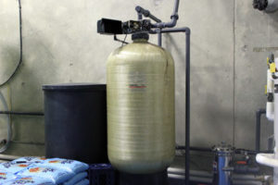
ION EXCHANGE METHOD
Ion Exchange The step in our purification process is the removal of various metallic elements through a process known as ion exchange. Sometimes referred to as water “softening,” ion exchange utilizes a large tank which is filled with a special, negatively-charged resin. The resin beads serve as bases or sites for the ion exchange to actually take place.
As water passes through the ion exchange resin, metallic ions, which carry a strong positive charge, displace the more weakly charged sodium and potassium ions. The metallic ions are thus trapped via electromagnetic attraction to the resin particles.

Slide 7
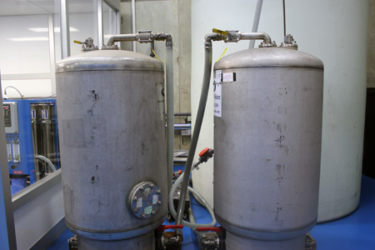
ACTIVATED CARBON METHOD
Activated Carbon Towers Once the water passes through the ion exchange system, it moves into over-sized granular activated carbon beds. Carbon filtration (also known as charcoal filtration), which utilizes a process known as adsorption, is a particularly effective technique for chlorine removal. Pesticides, herbicides, and other organic contaminants (especially volatile organics) are also removed at this stage.
Carbon also does an excellent job of removing trihalomethanes (THMs) from the water.

Slide 8
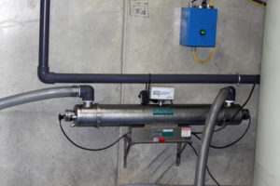
ULTRAVIOLET LIGHT METHOD
Ultraviolet Light
At this step in the process, the water passes through a special chamber which houses a large ultraviolet light source. This ultraviolet light acts as a powerful sterilizing agent. If any bacteria, viruses, or other microbiological contaminants are present in the water, the ultraviolet light at this particular wavelength destroys the genetic material within these organisms, eliminating the possibility of bacterial or viral reproduction and proliferation. The organisms quickly die and are captured and removed during the prefiltering before the reverse osmosis purification process.

Slide 9
ONE MICRON PRE-FILTER
One Micron Pre-Filter
Once through the ultraviolet light, our water then passes through another set of absolute filters – these being of the 1-Micron pore size – meaning that nothing larger than 1 Micron will pass through. A 1 Micron filter is capable of removing viruses, bacteria, cryptosporidium and various other deleterious bugs.

Slide 10
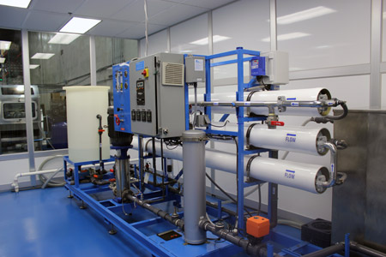
REVERSE OSMOSIS METHOD
Many people have heard about the process of osmosis. Osmosis is a naturally occurring process whereby water passes across a membrane due to a pressure differential between one side of the membrane and the other.
As osmosis takes place, the concentration of dissolved material on each side of the membrane moves closer to an equilibrium state. That is, the more concentrated solution will tend to become more diluted, and the more diluted solution will tend to become more concentrated.
In reverse osmosis, high pressure is used to force water across a membrane while impurities are left behind. In other words, the high pressure causes the impurities to become more concentrated on one side of the membrane. Only the pure water is able to cross the membrane; even the dissolved impurities which cannot be removed by conventional filtration are captured and eliminated by reverse osmosis purification system.

Slide 11
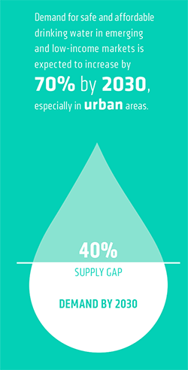
ANALYSIS
Today, more than two billion people—27 percent of the world population—lack access to safe water. Of these, 780 million do not have access to improved water sources, like household taps, public standpipes, boreholes, protected wells, or rainwater collection systems, that produce safe drinking water. The rest do have access to one or more of these sources, yet the water available from them is not safe for consumption.
The urban populations are expected to grow by 70 percent by 2030 while water usage is expected to rise by 50 percent.

Slide 12
CONCLUSION
Filtration methods proved helpful even though they were done on a small scale. If this method was expanded, it would be able to improve several factors of water, including pH levels, hardness, chlorine levels, and alkalinity levels. The water quality is increased and is therefore safer to drink.
The activated charcoal was the most effective method, and is also capable of removing airborne toxins and gases from water and from the environment. Not only did the activated charcoal help purify the water, but it is also good for the environment overall. Because carbon is a natural resource and is fairly inexpensive, it is the best nature-friendly option for purifying water. In addition to this, it can be activated with boiling water to reduce the carbon emissions formed when activating it to the state in which it is able to purify water.
On conclusion, we were made more aware of other water filtration methods, their practicality, and their benefits. Low quality water can lead to health hazards that can be avoided by putting into place these safe, inexpensive, and effective water filtration techniques.

